Slide 1
Real Estate Listings & Filters App
shaik Mohammad zaid
RVIT

Slide 2
Abstract & Objective
Abstract:
Browse, filter, and schedule real estate listings efficiently.
Access property details and agent contact easily
Objective:
Show properties clearly.
Filter by price, type, and location.
View details, contact agents, save favorites, schedule visits.

Slide 3
Tools & Technologies
FLUTTER & DART
ANDROID STUDIO / VS CODE
EMULATOR / DEVICE
GOOGLE MAPS API (FOR MAP VIEW)

Slide 4
System Architecture
APP FLOW: SPLASH → LOGIN/SIGNUP → HOME/LISTINGS → LISTING DETAIL → CONTACT AGENT
INCLUDE SIMPLE FLOWCHART DIAGRAM HERE.

Slide 5
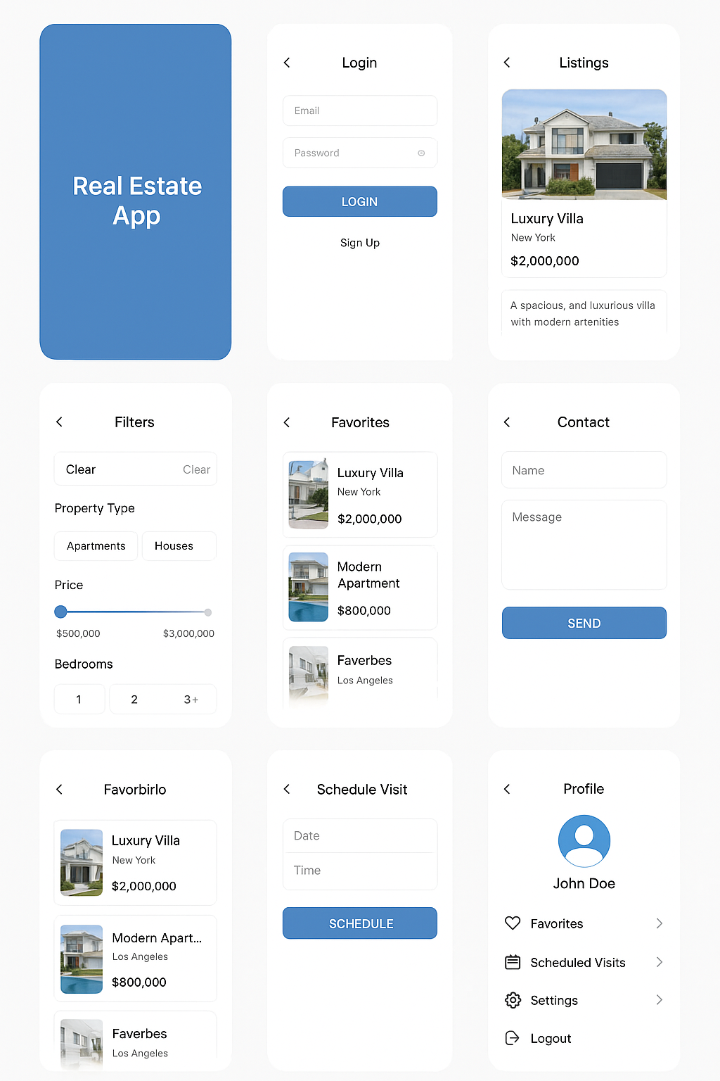
Key Features (Screenshots)

Slide 6
Additional Features
Filters: Price, property type, location
Map View: Display properties on map
Favorites: View saved properties
Schedule Visit: Select date & time with agent
Profile: Edit info & logout

Slide 7
Conclusion
Easy Property Browsing
Efficient Filtering & Scheduling
User-friendly Ui
Future Scope: Payment, Chat, Ai Recommendations

